Slide 1
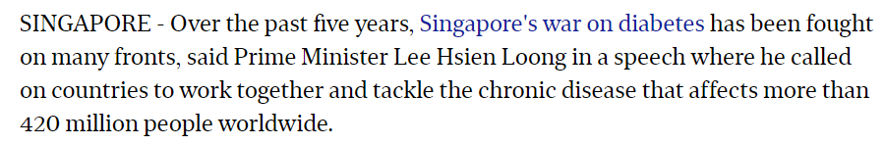
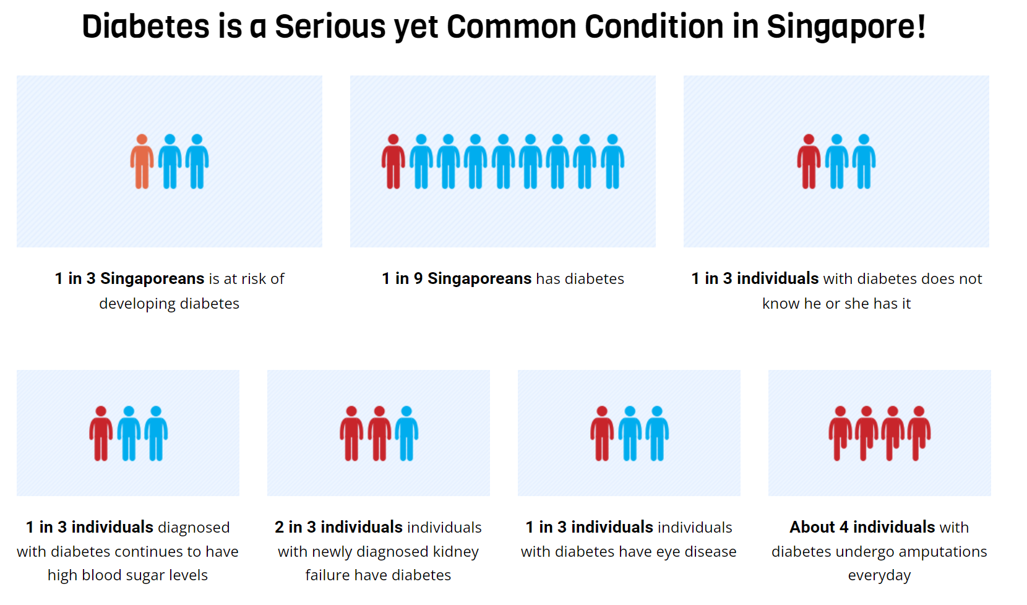
Problem - Increasing incidence of diabetes in Singapore
It is an insidious medical condition: It does not appear as a top cause of death, but many heart attacks, strokes, and kidney failures in fact trace back to diabetes. Long-term complications include cardiovascular disease, nerve damage (neuropathy), kidney damage (nephropathy), eye damage (retinopathy), foot damage and Alzheimer’s
https://www.youtube.com/watch?v=wQAu0xHd8tc

Slide 2
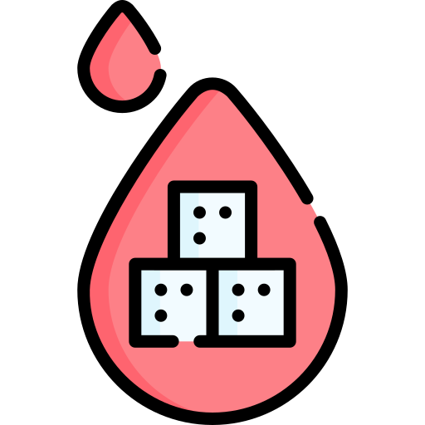
Problem - Re-admission of patients with comorbidities associated with diabetes
What counts as a readmission?
A subsequent acute care inpatient admission of the same patient within 30 days of discharge of the initial inpatient acute care admission
Adult patients with diabetes mellitus (DM) represent one-fifth of all 30-day unplanned hospital readmissions
Why is readmission bad?
Unplanned hospital readmissions are costly (US$17.4 billion in 2004)
Disruptive to patients’ work schedules and a cause for worry for close friends and family
HOWEVER, these readmissions are actually preventable - we want an intelligent model to catch and identify these cases

Slide 3

Why predict re-admission?
Existing routinely captured data can be used to develop prediction models that flag high risk patients during their index admission, potentially helping to support clinical decisions and prevent such readmissions
Reducing hospital readmission rates was one of the World Health Organization’s top strategic priorities as controlling unnecessary hospital readmissions not only reduces wasteful spending but improves patients’ quality of life
M. E. Png, J. Yoong, C. Chen, C. S. Tan, E. S. Tai, E. Y. Khoo, and H. L. Wee, “Risk factors and direct medical cost of early versus late unplanned readmissions among diabetes patients at a tertiary hospital in Singapore,” Current Medical Research and Opinion, vol. 34, no. 6, pp. 1071–1080, 2018.

Slide 4
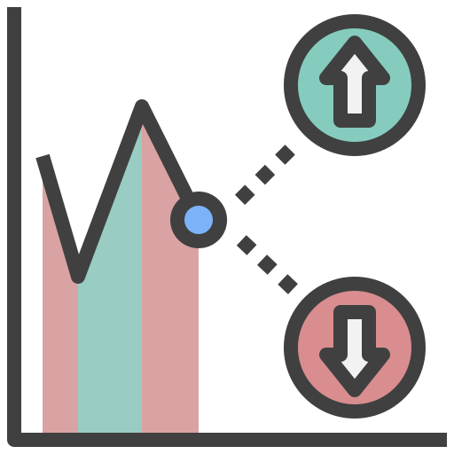
Solution - Identifying Patients at Risk of Re-admission
Idea: To identify patients with high risk of re-admission so that healthcare practitioners can intervene to reduce their risk factors
Deep Learning Solution: TabNet - Attentive Interpretable Tabular Learning*
Facilitate equitable distribution of healthcare resources - only dispense to high-risk patients
Allow hospitals and clinics to identify at-risk patients, prompting consultations with physicians for curation of management plans
Respect of patient autonomy (one of the 4 pillars of medicine) by keeping them informed
*S. Ö. Arik and T. Pfister, “TabNet: Attentive interpretable tabular learning,” Proceedings of the AAAI Conference on Artificial Intelligence, vol. 35, no. 8, pp. 6679–6687, 2021.

Slide 5

TabNet vs Machine Learning Models
Dataset: Diabetes 130-US hospitals for years 1999-2008 Data Set
Models to compare with: Random Forest, Naive Bayes, Tree Ensembles*
Dataset Limitations: The distribution of the target variable was unbalanced. Most of the patients in the dataset had no readmission record (53.69%), with only 11.22% having been readmitted within 30 days (< 30), when the remaining patients (35.09%) being readmitted beyond 30 days (> 30) after the first discharge.
*Y. Shang, K. Jiang, L. Wang, Z. Zhang, S. Zhou, Y. Liu, J. Dong, and H. Wu, “The 30-days hospital readmission risk in diabetic patients: Predictive modeling with Machine Learning Classifiers,” BMC Medical Informatics and Decision Making, vol. 21, no. S2, 2021.

Slide 6

Advantages of TabNet
Use of an attentive layer for features selection essentially allowing for decision boundaries
Enabling interpretability
Better learning as the learning importance is given to the most useful features
Dense layers of feature transformer block
Allows for further feature generation
Allow the model to pick out new features and increase the robustness of the model.
Outperforms Boosted Trees
Popular model for learning tabular data
*S. Ö. Arik and T. Pfister, “TabNet: Attentive interpretable tabular learning,” Proceedings of the AAAI Conference on Artificial Intelligence, vol. 35, no. 8, pp. 6679–6687, 2021.

Slide 7
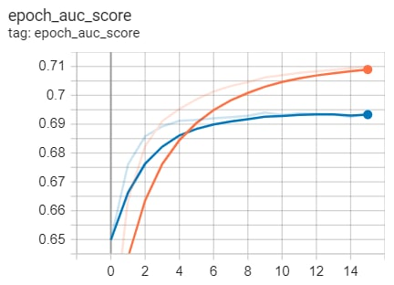
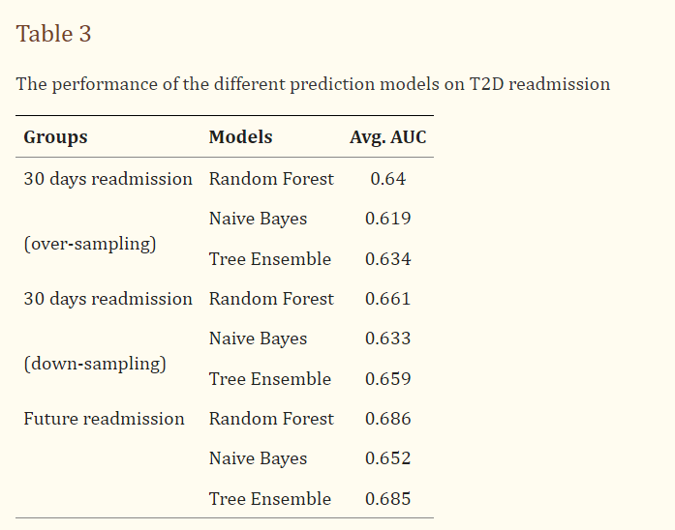
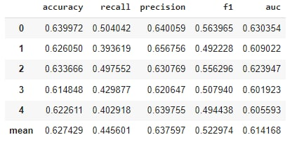
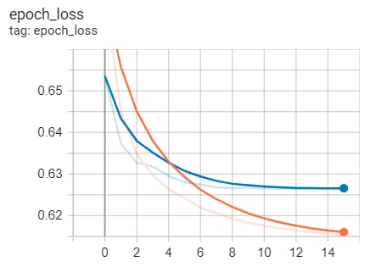
Results
TabNet 5-fold cross validation yields comparable results
UAC Scores using other ML Algorithms
AUC score and loss against epoch for training (orange) and validation (blue) set

Slide 8

Future Works
Hyperparameter tuning
To optimize performance of Tabnet model
Collecting a more balanced dataset
To mitigate the problem of underrepresentation of patients that are re-admitted in the training data

